Slide 1
Indexes

Slide 2
Indexes
What are indexes?
Types
Properties
Why use indexes?
How to create indexes.
Commands to check indexes and plans.
How to drop indexes.

Slide 3
What are indexes?
Indexes are special data-structures that store a subset of your data in an easily traversable format.
MongoDB stores indexes in a b-tree format which allows for efficient access to the index content.
Proper index use is good and makes a system run optimally.Improper index use can bring a system to a grinding halt.
Indexes are used by MongoDB to answer more efficiently queries.
Without indexes MongoDB have to scan the whole collection.

Slide 4
Indexes Types
_id
Simple
Compound
Multikey
Full-Text
Geo-spatial
Hashed

Slide 5
The _id index
All MongoDB collections have an index on the _id field that exists by default. If
applications do not specify a value for _id MongoDB will create an _id field with an ObjectId value.
The _id index is unique, and prevents clients from inserting two documents with the same value for the _id field.
The _id index is automatically created and cannot be removed.
This is the same as a primary key in traditional RDBMS.
Default value is a 12-byte ObjectId:
4-byte time stamp,3-byte machine id,2-byte process id, 3-byte counterSim

Slide 6
Simple index
User defined index on a single field of a document.
Example: Create an Ascending Index on a Single Field
Consider, a collection named records that holds documents that resemble the following sample document:
The following operation creates an ascending index on the score field of the records collection:
The created index will support queries that select on the field score, such as the following:
{
"_id": ObjectId("570c04a4ad233577f97dc459"),
"score": 1034,
"location": { state: "NY", city: "New York" }
}
db.records.createIndex( { score: 1 } )
db.records.find( { score: 2 } )
db.records.find( { score: { $gt: 10 } } )

Slide 7
Create an Index on an Embedded Field
Indexes on embedded fields allow you to use a “dot notation,” to introspect into embedded documents.
Consider a collection named records that holds documents that resemble the following sample document
The following operation creates an index on the location.state field
The created index will support queries that select on the field location.state, such as the following
{
"_id": ObjectId("570c04a4ad233577f97dc459"),
"score": 1034,
"location": { state: "NY", city: "New York" }
}
db.records.createIndex( { "location.state": 1 } )
db.records.find( { "location.state": "CA" } )
db.records.find( { "location.city": "Albany", "location.state": "NY" } )

Slide 8
Create an Index on Embedded Document
Consider a collection named records that holds documents that resemble the following sample document.
The location field is an embedded document, containing the embedded fields city and state. The following command creates an index on the location field as a whole.
The following query can use the index on the location field.
{
"_id": ObjectId("570c04a4ad233577f97dc459"),
"score": 1034,
"location": { state: "NY", city: "New York" }
}
db.records.createIndex( { location: 1 } )
db.records.find( { location: { city: "New York", state: "NY" } } )

Slide 9
Compound index
A compound index is created over two or more fields in a document
This is similar to a phone book where you can find the phone number of a person given their first and last names.
MongoDB imposes a limit of 32 fields for any compound index.
To create a compound index use an operation that resembles the following prototype
The value of the field in the index specification describes the kind of index for that field.
For example, a value of 1 specifies an index that orders items in ascending order. A value of -1 specifies an index that orders items in descending order.
db.collection.createIndex( { <field1>: <type>, <field2>: <type2>, ... } )

Slide 10
Consider a collection named products that holds documents that resemble the following document
The following operation creates an ascending index on the item and stock fields:
The index will contain references to documents sorted first by the values of the item field and, within each value of the item field, sorted by values of the stock field.
In addition to supporting queries that match on all the index fields,
{
"_id": ObjectId(...),
"item": "Banana",
"category": ["food", "produce", "grocery"],
"location": "4th Street Store",
"stock": 4,
"type": "cases"
}
db.products.createIndex( { "item": 1, "stock": 1 } )
db.products.find( { item: "Banana" } )
db.products.find( { item: "Banana", stock: { $gt: 5 } } )

Slide 11
Multikey index
A multikey index is an index that’s created on a field that contains an array.
If using in a compound index, only a single field in a given document can be an array.
You will get one entry in the index for every item in the array for the given document. This means if you have an array with 100 items, that document will have 100 index entries.
Example
You cannot create a compound multikey index { a: 1, b: 1 } on the collection since both the a and b fields are arrays.
db.coll.createIndex( { <field>: < 1 or -1 > } )
{ _id: 1, a: [ 1, 2 ], b: [ 1, 2 ], category: "AB - both arrays" }

Slide 12
Text index
Text indexes can include any field whose value is a string or an array of string elements.
The following example creates a text index on the fields subject and comments
When creating a text index on multiple fields, you can also use the wildcard specifier ($**).
db.reviews.createIndex( { comments: "text" } )
db.reviews.createIndex(
{
subject: "text",
comments: "text"
}
)
db.collection.createIndex( { "$**": "text" } )

Slide 13
Geo-spatial index
A geo-spatial index will allow you to determine distance from a given point.
Works on both planar and spherical geometries.
MongoDB allows us to create special Indexes for geospatial queries using geospatial Indexes.
The value can be 2d > legacy coordinate pairs (longitude, latitude)
db.places.createIndex( { location: "2D" } )

Slide 14
Hashed indexes
A hashed index is used in hash based sharding, and allows for a more randomized distribution.
Hashed indexes cannot contain compound keys or be unique.
Hashed indexes can contain the key in both a hashed and non-hashed version. The non- hashed version will allow for range based queries.
To create a hashed index, specify hashed as the value of the index key, as in the following example
db.collection.createIndex( { _id: "hashed" } )

Slide 15
Index properties
Unique
Sparse
TTL
Partial

Slide 16
Unique
The unique property allows for only a single value for the indexed field, or combination of fields for a compound index.
A unique index can only have a single null or missing field value for all documents in the collection.
db.collection.createIndex( <key and index type specification>, { unique: true } )
db.members.createIndex( { "user_id": 1 }, { unique: true } )

Slide 17
Sparse
The sparse property allows you to index only documents that contain a value for the given field.
db.collection.createIndex({“kids”: 1}, {“sparse”: true})
A sparse index will not be used if it would result in an incomplete result set, unless specifically hinted.
db.collection.find({“kids”: {“$gte”: 5})

Slide 18
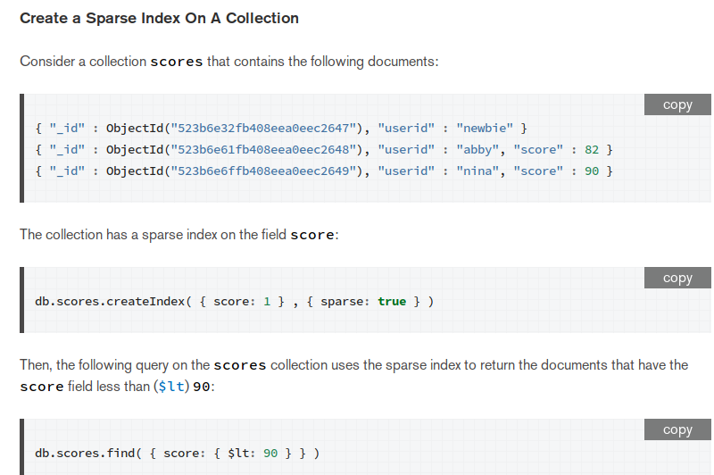

Slide 19
TTL
The TTL property allows for the automatic removal of documents after a given time period.
db.collection.createIndex({“accessTime”: 1}, {“expireAfterSeconds”:“1200”})
The indexed field should contain an ISODate() value. If any other type is used the document will not be removed.
The TTL removal process runs once every 60 seconds so you might see the document even though the time has expired.

Slide 20
Partial
The partial property allows you to index a subset of your data.
db.collection.createIndex({“movie”: 1, “reviews”: 1}, {“rating”: {“$gte”: 4}})
The index will not be used if it would provide an incomplete result set (similar to the sparse index).

Slide 21
Why use indexes
Efficiently retrieving document matches
Equality matching
Inequality or range matching
Sorting
Lack of a usable index will cause MongoDB to
scan the entire collection.

Slide 22
Removing indexes
The command to remove indexes is similar to the one to create the index.
db.flights.dropIndex({“Origin”: 1, “Dest”: -1})

Slide 23
View all indexes in a database
To view all indexes in a database use the following command:
db.system.indexes.find()
For each index you’ll see the fields the index was created with, the name of the index and the namespace (db.collection) that the index was built on.

Slide 24
View indexes for a given collection
To view all indexes for a given collection use the following command:
db.collection.getIndexes()
This returns the same information as the previous command, but is limited to the given collection.

Slide 25
View index sizes
To view the size of all indexes in a collection:
db.collection.stats()
You will see the size of all indexes and the size of each individual index in the results. The sizes are in bytes.

Slide 26
How to see if an index is used
If you want to see if an index is used, append the .explain() operator to your query
db.flights.find({“Origin”: “DEN”}).explain()
The explain operator has three levels of verbosity:
queryPlanner - this is the default, and it returns the winning query plan
executionStats - adds execution stats for the plan
allPlansExecution - adds stats for the other candidate plans

Slide 27
What are indexes?
Indexes are special data-structures that store a subset of your data in an easily traversable format.
MongoDB stores indexes in a b-tree format which allows for efficient access to the index content.
Proper index use is good and makes a system run optimally.Improper index use can bring a system to a grinding halt.
Indexes are used by MongoDB to answer more efficiently queries.
Without indexes MongoDB have to scan the whole collection.

Slide 28
References
https://docs.mongodb.com/manual/indexes/

